Slide 1

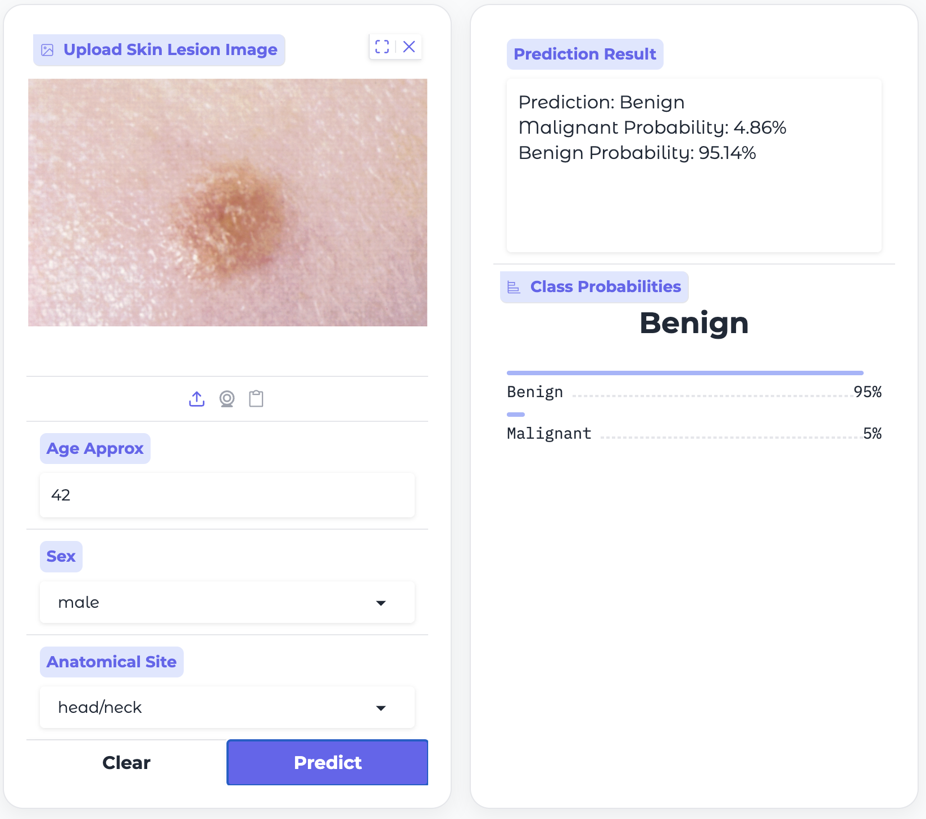
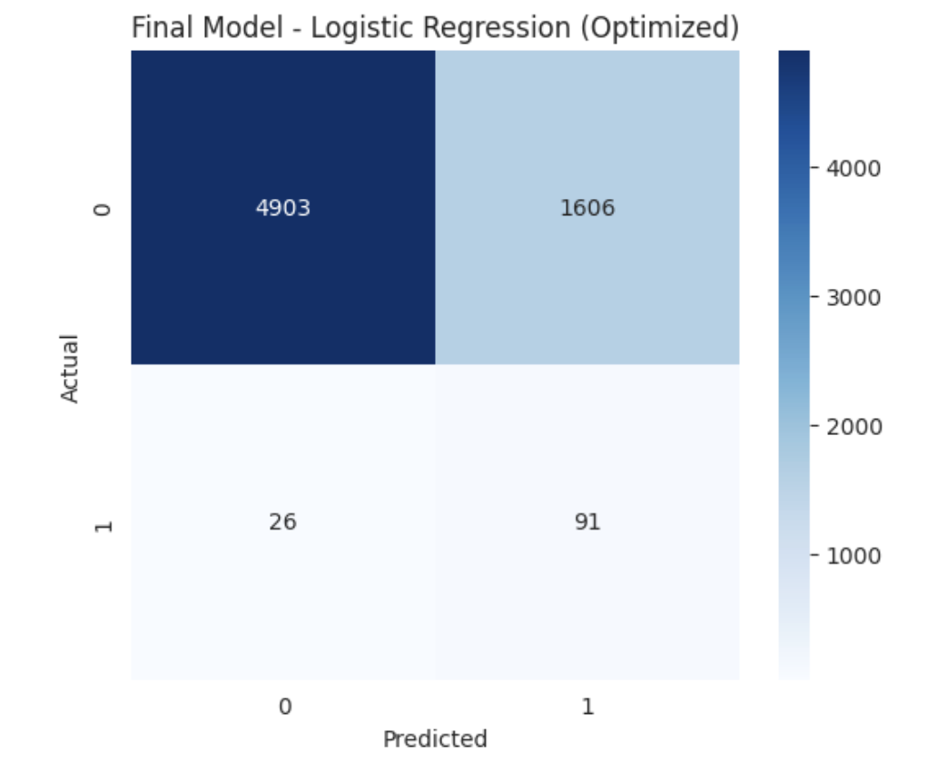
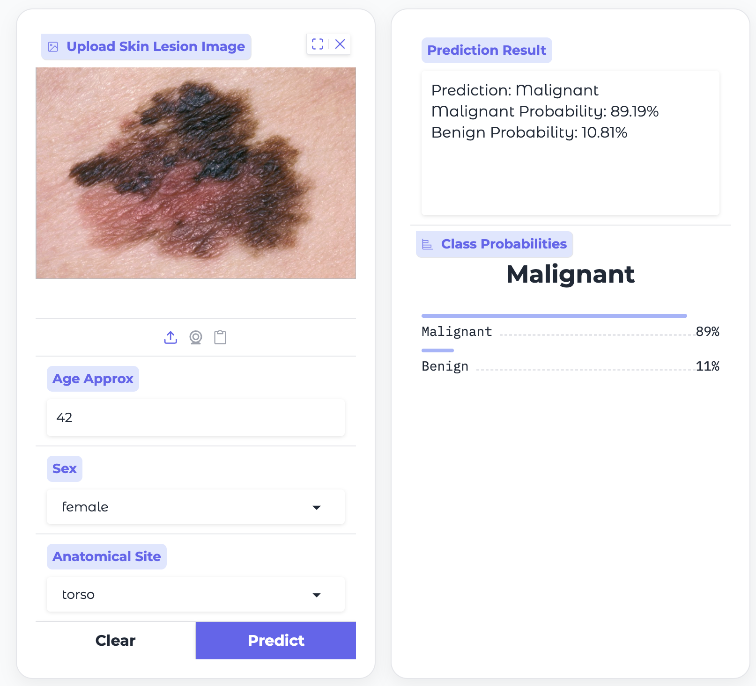
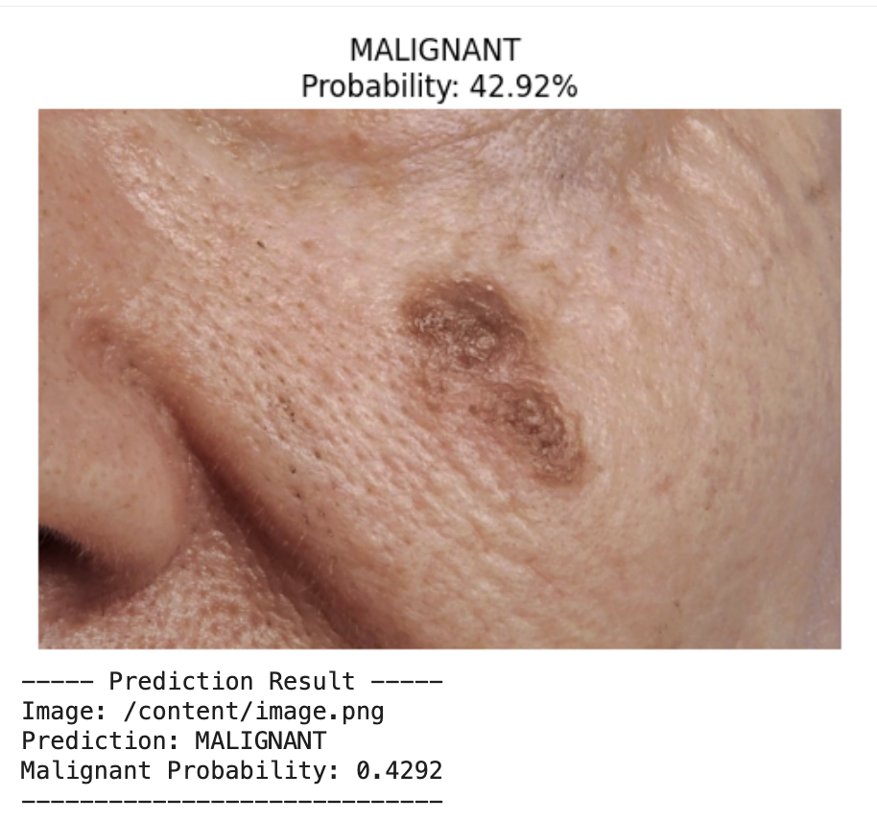
A SIIM-ISIC Melanoma Machine Learning Classification Project
Maria Vasai, Selam Saleh, Olivia Sampson, Ugyen Thukzom
ugyenthukzom@gmail.com, ssaleh25@myseneca.ca, osampson1@myseneca.ca, mvasai@myseneca.ca
Seneca Polytechnic
Abstract
Challenges
Examples
Evaluations
Recall: 0.78, primary metric used to identify malignant cases and minimize false negatives.
Precision: 0.05, indicates a higher number of false positives due to the model prioritizing recall.
F1-Score: 0.10, shows the trade-off between precision and recall in an imbalanced setting.
AUC-ROC Curve: 0.846, demonstrating strong ability to distinguish between benign and malignant classes across thresholds.
This project develops a machine learning pipeline for early melanoma detection using the ISIC dermoscopic dataset, addressing the challenge of extreme class imbalance where malignant cases represent less than 2% of the data. The approach combines pre-trained Convolutional Neural Networks (CNNs) for feature extraction with Random Over Sampling to balance the dataset and feature selection techniques to retain the most relevant predictors. Emphasizing clinical relevance, the model is optimized to maximize recall, prioritizing the detection of malignant lesions and reducing the risk of false negatives. The findings demonstrate that the integration of deep learning features with strategic threshold tuning provides a promising foundation for future diagnostic decision-support systems in oncology.
Class Imbalance: A ~50:1 ratio heavily biased the model toward benign predictions.
High Computational Latency: Processing large volumes of image data increased training time and resource demands.
Dimensionality: Feature explosion from image data complicated model training and increased model complexity.
Diagnostic Risk: Critical trade-off between maximizing recall and avoiding excessive false positives.
Precision Constraints: Despite improvements, achieving perfect accuracy remained difficult due to the complexity of lesion patterns.
\
Framework
Feature Extraction: Used ResNet18 to extract image features
Data Combination: Extracted image features were combined with patient metadata.
Data Preprocessing: Handled missing values and encoded categorical variables for modeling.
Feature Selection: Reduced dimensionality by selecting the most relevant features for classification .
Class Balancing: Applied Random Over Sampling to address class imbalance
Model Development: Evaluated multiple models, with Logistic Regression performing the best.
Model Optimization: Tuned thresholds to prioritize recall and improve malignant case detection.
Evaluation: Assessed performance using recall-focused metrics
Prediction Pipeline: Generated a final prediction pipeline with probability scores for new inputs.
Conclusions
Our results demonstrate that the proposed framework is effective for melanoma detection. By combining ResNet18-based feature extraction with patient metadata and targeted preprocessing, the model was able to reliably identify malignant cases. Random Over Sampling and feature selection improved performance, with Logistic Regression performing best when optimized for recall. While the model is not perfectly accurate, it reduces the risk of missing critical cases. Additionally, analysis suggests that patient metadata—particularly age—has a noticeable influence on predictions, highlighting its importance alongside image features.
Objective
Lesion Classification: Develop a machine learning model to classify skin lesions as benign or malignant using image features and patient metadata.
Class Imbalance Handling: Apply techniques to address dataset imbalance and improve detection of rare malignant cases.
Feature Extraction: Use pre-trained Convolutional Neural Networks (CNNs) to extract meaningful visual features from images.
Feature Optimization: Apply feature selection to retain the most relevant predictors and improve model performance.
Recall Optimization: Optimize the model to maximize recall and reduce the risk of missing malignant cases.
References
SIIM-ISIC. SIIM-ISIC Melanoma Classification Dataset, Kaggle Competition, 2020.

